Slide 1

Dynamic Programming, Backtracking and Branch and Bound
Design & Analysis of Algorithms
ACSE0501
Ms. Anamika Chaudhary
Assistant Professor
DS Department
B.Tech 5th Sem

Slide 2

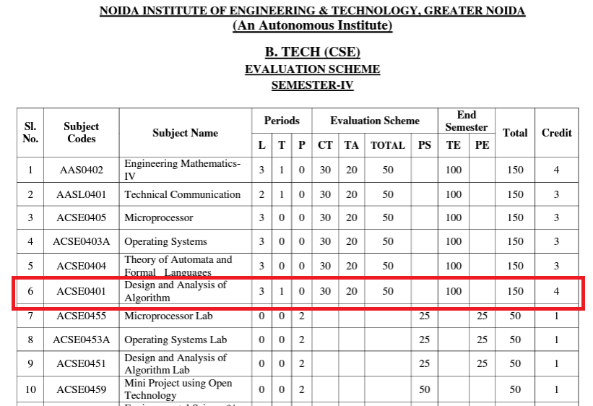
Evaluation Scheme

Slide 3

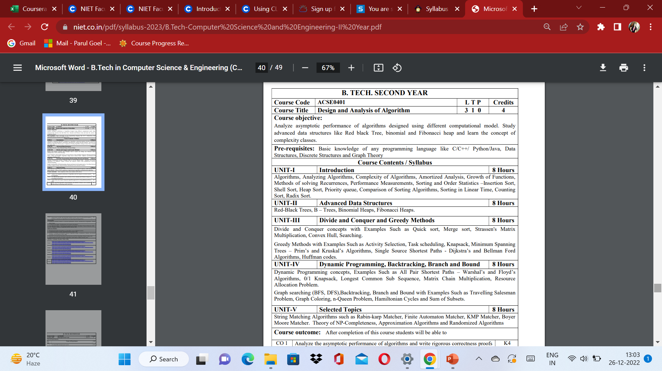
Syllabus

Slide 4
Course Objective
Upon completion of this course, students will be able to do the following:
Analyze the asymptotic performance of algorithms.
Write rigorous correctness proofs for algorithms.
Demonstrate a familiarity with major algorithms and data structures.
Apply important algorithmic design paradigms and methods of analysis.
Synthesize efficient algorithms in common engineering design situations.

Slide 5
Course Outcome
At the end of the semester, the student will be able:
 | Description | Bloom’s Taxonomy
CO1 | To have knowledge of basic principles of algorithm design and Analysis, asymptotic notations and growth of functions for time and space complexity analysis and applying the same in different sorting algorithms | Knowledge, analysis And design
CO2 | To apply different problem-solving approaches for advanced data structures | Knowledge, analysis And apply
CO3 | To apply divide and conquer method for solving merge sort, quick sort, matrix multiplication and Greedy Algorithm for solving different Graph Problem. | Knowledge, analysis and Apply
CO4 | To analyze and apply different optimization techniques like dynamic programming, backtracking and Branch & Bound to solve the complex problems | Knowledge, Analysis And Apply
CO5 | To understand the advanced concepts like NP Completeness and Fast Fourier Transform, to analyze and apply String Matching, Approximation and Randomized Algorithms to solve the complex problems | Knowledge, Analysis and Apply

Slide 6
Program Outcome
At the end of the semester, the student will be able:
POs | Engineering Graduates will be able to
PO1 | Engineering Knowledge
PO2 | Problem Analysis
PO3 | Design & Development of solutions
PO4 | Conduct Investigation of complex problems
PO5 | Modern Tool Usage
PO6 | The Engineer and Society
PO7 | Environment and sustainability
PO8 | Ethics
PO9 | Individual & Team work
PO10 | Communication
PO11 | Project management and Finance
PO12 | Life Long Learning

Slide 7
CO-PO and PSO Mapping
Design and Analysis of Algorithm (ACSE 0401)
CO.K | PO1 | PO2 | PO3 | PO4 | PO5 | PO6 | PO7 | PO8 | PO9 | PO10 | PO11 | PO12
ACSE0401.1 | 3 | 3 | 3 | 3 | 2 | - | - | - | 2 | 2 | - | 3
ACSE0401.2 | 3 | 3 | 3 | 3 | 2 | 2 | - | 1 | 1 | 1 | - | 3
ACSE0401.3 | 3 | 3 | 2 | 3 | 3 | 2 | - | 2 | 1 | 1 | 2 | 3
ACSE0401.4 | 3 | 3 | 3 | 3 | 2 | 2 | - | 2 | 2 | 1 | 3 | 3
ACSE0401.5 | 2 | 2 | 2 | 2 | 2 | 2 | - | 2 | 1 | 1 | 1 | 2
Average | 2.8 | 2.8 | 2.6 | 2.8 | 2.2 | 1.6 | - | 1.8 | 1.4 | 1.2 | 1.2 | 2.8

Slide 8
Program Educational Objectives(PEOs)
PEO1: To have an excellent scientific and engineering breadth so as to
comprehend, analyze, design and provide sustainable solutions for
real-life problems using state-of-the-art technologies.
PEO2:To have a successful career in industries, to pursue higher studies or
to support entrepreneurial endeavors and to face global challenges.
PEO3:To have an effective communication skills, professional attitude,
ethical values and a desire to learn specific knowledge in emerging
trends, technologies for research, innovation and product
development and contribution to society.
PEO4: To have life-long learning for up-skilling and re-skilling for
successful professional career as engineer, scientist, enterpreneur
and bureaucrat for betterment of society

Slide 9
Result Analysis
2022-23
Overall Result: 97%
Ms Priya(Section A): 98.4
Mr. Manish Chaudhry(Section B): 98.46
Ms. Priya(Section C): 94.28
2021-22
Overall Result: 94%
Mr. Nagesh Sharma (Section A&B): 95.59
Mr. Dileep Kushwaha (Section C): 94.12

Slide 10
End Semester Question Paper Template
B TECH
(SEM-IV) THEORY EXAMINATION 20__-20__
COMPILER DESIGN
Time: 3 Hours Total Marks: 100
Note: 1. Attempt all Sections. If require any missing data; then choose suitably.
SECTION A
Attempt all questions in brief. 2 x 10 = 20
Q.No. | Question | Marks | CO
1 |  | 2
2 |  | 2
. |  | .
10 |  | 2

Slide 11
End Semester Question Paper Templates
SECTION B
2. Attempt any three of the following: 3 x 10 = 30
SECTION C
3. Attempt any one part of the following: 1 x 10 = 10
Q.No. | Question | Marks | CO
1 |  | 10
2 |  | 10
. |  | .
5 |  | 10
Q.No. | Question | Marks | CO
1 |  | 10
2 |  | 10

Slide 12
End Semester Question Paper Templates
4. Attempt any one part of the following: 1 x 10 = 10
5. Attempt any one part of the following: 1 x 10 = 10
6. Attempt any one part of the following: 1 x 10 = 10
Q.No. | Question | Marks | CO
1 |  | 10
2 |  | 10
Q.No. | Question | Marks | CO
1 |  | 10
2 |  | 10
Q.No. | Question | Marks | CO
1 |  | 10
2 |  | 10

Slide 13
Prerequisite and Recap
Prerequisite
Basic concept of c programming language.
Concept of stack, queue and link list.
Recap
Flow Chart
Algorithm

Slide 14
Course Objective
Upon completion of this course, students will be able to do the following:
Analyze the asymptotic performance of algorithms.
Write rigorous correctness proofs for algorithms.
Demonstrate a familiarity with major algorithms and data structures.
Apply important algorithmic design paradigms and methods of analysis.
Synthesize efficient algorithms in common engineering design situations.

Slide 15
Unit Content
Dynamic programming
All pair shortest paths – Warshal’s and Floyd’s algorithms,
Knapsack
Longest Common Sub Sequence
Matrix Chain Multiplication
Resource allocation problem(BFS, DFS)
Backtracking
Branch and Bound with examples such as Travelling Salesman Problem
Graph Coloring
n-Queen Problem
Hamiltonian Cycles
Sum of subsets
.

Slide 16
Unit Objective
This objective of this unit is to make students understand about
Dynamic Programming
Back tracking
Branch and Bound ..
.

Slide 17
Topic Objective
This objective of this topic is to make students understand about
Concepts of dynamic programming.
Knapsack Problem(0/1)
Floyd Warshall Algorithm
Resource Allocation problem

Slide 18
Dynamic Programming(CO4)
In the divide-and-conquer strategy, you divide the problem to be solved into subproblems.
The subproblems are further divided into smaller subproblems.
That task will continue until you get subproblems that can be solved easily.
The basic idea of dynamic programming is to use a table to store the solutions of solved subproblems.
If you face a subproblem again, you just need to take the solution in the table without having to solve it again.
Therefore, the algorithms designed by dynamic programming are very effective.

Slide 19
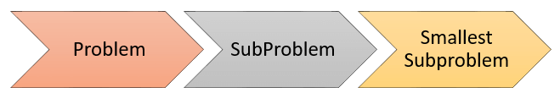
Dynamic Programming
To solve a problem by dynamic programming, you need to do the following tasks:
Find solutions of the smallest subproblems.
Find out the formula (or rule) to build a solution of subproblem through solutions of even smallest subproblems.
Create a table that stores the solutions of subproblems. Then calculate the solution of subproblem according to the found formula and save to the table.
From the solved subproblems, you find the solution of the original problem.

Slide 20
Dynamic Programming(CO4)
All Pair Shortest Path(Floyd-Warshall algorithm)
The all pair shortest path algorithm is also known as Floyd-Warshall algorithm is used to find all pair shortest path problem from a given weighted graph.
As a result of this algorithm, it will generate a matrix, which will represent the minimum distance from any node to all other nodes in the graph.
At first the output matrix is same as given cost matrix of the graph. After that the output matrix will be updated with all vertices k as the intermediate vertex.
The time complexity of this algorithm is O(V³), here V is the number of vertices in the graph.

Slide 21
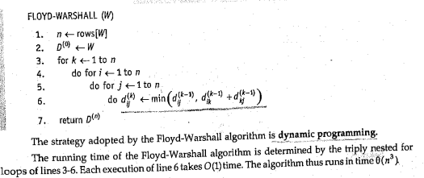
Dynamic Programming(CO4)

Slide 22
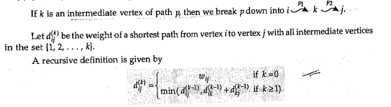
Dynamic Programming(CO4)

Slide 23
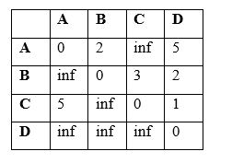
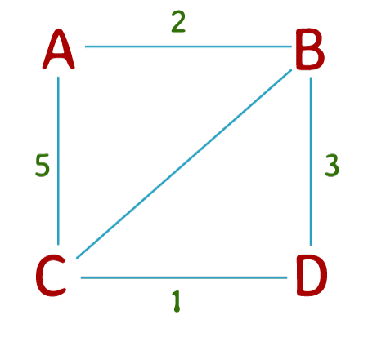
Dynamic Programming(CO4)
In the first iteration of the set of rules, we keep in mind the possibility of the usage of vertex 1 (A) as an intermediate vertex in paths among all pairs of vertices.
If the space from vertex 1 to vertex 2 plus the space from vertex 2 to vertex three is much less than the present-day distance from vertex 1 to vertex three, then we replace the matrix with this new distance.
We try this for each possible pair of vertices.

Slide 24
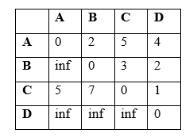
Dynamic Programming(CO4)
In the second iteration, we recollect the possibility to use of vertex 2 (B) as an intermediate vertex in paths among all pairs of vertices.
We replace the matrix in the same manner as earlier before.

Slide 25
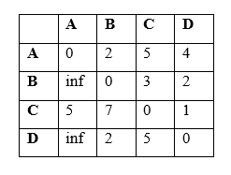
Dynamic Programming(CO4)
In the third iteration, we consider the possibility of using vertex 3 (C) as an intermediate vertex in paths between all pairs of vertices.

Slide 26
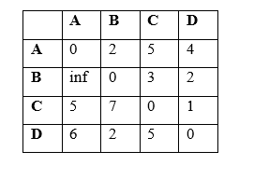
Dynamic Programming(CO4)
Finally, in the fourth and final iteration, we consider the possibility of using vertex 4 (D) as an intermediate vertex in paths between all pairs of vertices.

Slide 27
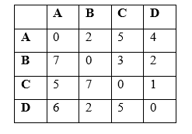
Dynamic Programming(CO4)
After the fourth iteration, we have got the shortest path between every pair of vertices in the graph.

Slide 28
Dynamic Programming(CO4)
Complexity of Floyd Warshall’s Algorithm:
Time Complexity : O (n3)
Space Complexity : O(n )
Applications of the Floyd Warshall Algorithm
Fast computation of Pathfinder networks
Inversion of real matrices
The transitive closure of directed graphs
Checking if an undirected graph is bipartite or not.
Shortest path in a graph

Slide 29
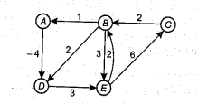
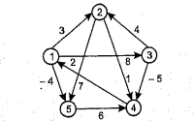
Dynamic Programming(CO4)
Q1. Apply Floyd Warshall algorithm on following graphs:

Slide 30
Dynamic Programming(CO4)
Knapsack problem(0/1)
Consider a thief gets into a home to rob and he carries a knapsack. There are fixed number of items in the home — each with its own weight and value — Jewellery, with less weight and highest value vs tables, with less value but a lot heavy.
To add fuel to the fire, the thief has an old knapsack which has limited capacity.
Obviously, he can’t split the table into half or jewelry into 3/4ths. He either takes it or leaves it.

Slide 31
Dynamic Programming(CO4)
Dynamic-Programming Approach
Let i be the highest-numbered item in an optimal solution S for W dollars. Then S' = S - {i} is an optimal solution for W - w_{i} dollars and the value to the solution S is V_{i} plus the value of the sub-problem.
We can express this fact in the following formula: define c[i, w] to be the solution for items 1,2, … , i and the max_{i}mum weight w.
The algorithm takes the following inputs
The max_{i}mum weight W
The number of items n
The two sequences v = <v₁, v₂, …, v_{n}> and w = <w₁, w₂, …, w_{n}>

Slide 32
Dynamic Programming(CO4)
Dynamic-0-1-knapsack (v, w, n, W)
for w = 0 to W do
c[0, w] = 0
for i = 1 to n do
c[i, 0] = 0
for w = 1 to W do
if w_{i} ≤ w then
if v_{i} + c[i-1, w-w_{i}] then
c[i, w] = v_{i} + c[i-1, w-w_{i}]
else c[i, w] = c[i-1, w]
else
c[i, w] = c[i-1, w]

Slide 33
Dynamic Programming(CO4)
Knapsack problem(0/1)
The set of items to take can be deduced from the table, starting at c[n, w] and tracing backwards where the optimal values came from.
If c[i, w] = c[i-1, w], then item i is not part of the solution, and we continue tracing with c[i-1, w]. Otherwise, item i is part of the solution, and we continue tracing with c[i-1, w-W].
Analysis
This algorithm takes θ(n, w) times as table c has (n + 1).(w + 1) entries, where each entry requires θ(1) time to compute.

Slide 34
Dynamic Programming(CO4)
Knapsack problem(0/1)
Steps
To calculate the maximum value that we can obtain with item i, we first need to compare the weight of item i with the knapsack’s weight capacity.
Obviously, if item i weighs more than what the knapsack can hold, we can’t include it, so it does not make sense to perform the calculation.
In that case, the solution to this problem is simply the maximum value that we can obtain without item i (i.e. the value in the row above, at the same column).

Slide 35
Dynamic Programming(CO4)
Knapsack problem(0/1)
However, suppose that item i weighs less than the knapsack’s capacity.
We thus have the option to include it, if it potentially increases the maximum obtainable value.
The maximum obtainable value by including item i is thus = the value of item i itself + the maximum value that can be obtained with the remaining capacity of the knapsack.
We obviously want to make full use of the capacity of our knapsack, and not let any remaining capacity go to waste.
Therefore, at row i and column j (which represents the maximum value we can obtain there), we would pick either the maximum value that we can obtain without item i, or the maximum value that we can obtain with item i, whichever is larger.

Slide 36
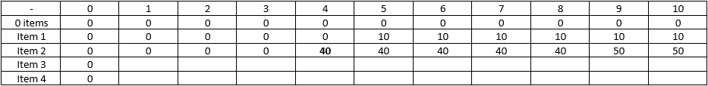
Dynamic Programming(CO4)
For Example
At row 3 (item 2), and column 5 (knapsack capacity of 4), we can choose to either include item 2 (which weighs 4 units) or not.
If we choose not to include it, the maximum value we can obtain is the same as if we only have item 1 to choose from (which is found in the row above, i.e. 0).

Slide 37
Dynamic Programming(CO4)
Knapsack problem(0/1)
If we want to include item 2, the maximum value we can obtain with item 2 is the value of item 2 (40) + the maximum value we can obtain with the remaining capacity (which is 0, because the knapsack is completely full already).
At row 3 (item 2), and column 10 (knapsack capacity of 9), again, we can choose to either include item 2 or not.
If we choose not to, the maximum value we can obtain is the same as that in the row above at the same column, i.e. 10 (by including only item 1, which has a value of 10).

Slide 38
Dynamic Programming(CO4)
Knapsack problem(0/1)
If we include item 2, we have a remaining knapsack capacity of 9 - 4 = 5.
We can find out the maximum value that can be obtained with a capacity of 5 by looking at the row above, at column 5.
Thus, the maximum value we can obtain by including item 2 is 40 (the value of item 2) + 10 = 50.

Slide 39
Dynamic Programming(CO4)
Knapsack problem(0/1)
We pick the larger of 50 vs 10, and so the maximum value we can obtain with items 1 and 2, with a knapsack capacity of 9, is 50.
Once the table has been populated, the final solution can be found at the last row in the last column, which represents the maximum value obtainable with all the items and the full capacity of the knapsack.
For more examples watch the following youtube link
https://www.youtube.com/watch?v=oTTzNMHM05I

Slide 40
Dynamic Programming(CO4)
Q1. Find optimal solution for 0/1 knapsack problem n=3 , W= 6
<w1, w2, w3 >= <2, 3, 3 >
<P1, P2, P3 >= <1, 2, 4 >
Q2. Find optimal solution for 0/ 1 knapsack problem using dynamic programming n= 4 , W=8
P= 1, 2, 5, 6
w = 2, 3, 4, 5

Slide 41
Dynamic Programming(CO4)
Resource Allocation problem
An optimal allocation of resources is defined by a maximum cost of a path from S to T.
A dynamic programming formulation for a k-stage is obtained by first noticing that every S to T path is result of a sequence k-2 decisions.
Let c(S, k) be a cost of path from node S to k and d( k, T) be the cost of path from node k to T, via. some intermediate node , which can be calculated recursively.
d(S,T)= max{c(S, k) +d (k,T)}

Slide 42
Longest Common Sub Sequence(CO4)
The longest common subsequence (LCS) is defined as the longest subsequence that is common to all the given sequences, provided that the elements of the subsequence are not required to occupy consecutive positions within the original sequences.
If S1 and S2 are the two given sequences then, Z is the common subsequence of S1 and S2 if Z is a subsequence of both S1 and S2. Furthermore, Z must be a strictly increasing sequence of the indices of both S1 and S2.
In a strictly increasing sequence, the indices of the elements chosen from the original sequences must be in ascending order in Z.

Slide 43
Longest Common Sub Sequence(CO4)
If S1={B,C,D,A,A,C,D} then, {A,D,B} cannot be a subsequence of S1 as the order of the elements is not the same (i.e. not strictly increasing sequence).
Let us understand LCS with an example:
If S1 = {B,C,D,A,A,C,D}
S2 = {A,C, D,B,A,C}
Then, common sub sequences are:
{B,C}{C,D,A,C}{D,A,C}{A,A,C}{A,C}{C,D}…
Among these sub sequences, {C,D,A,C} is the longest common subsequence. We are going to find this longest common subsequence using dynamic programming.

Slide 44
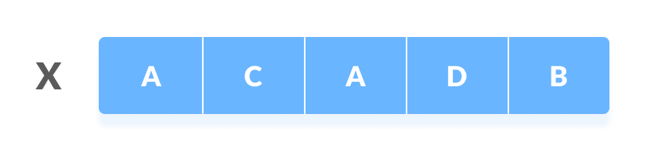
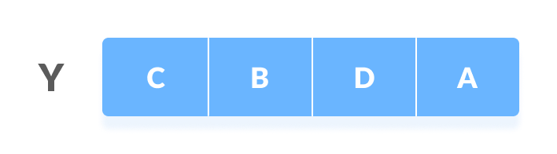
Longest Common Sub Sequence(CO4)
Using Dynamic Programming to find the LCS
Let us take two sequences:
The following steps are followed for finding the longest common subsequence.
Create a table of dimension n+1*m+1 where n and m are the lengths of X and Y respectively. The first row and the first column are filled with zeros.

Slide 45
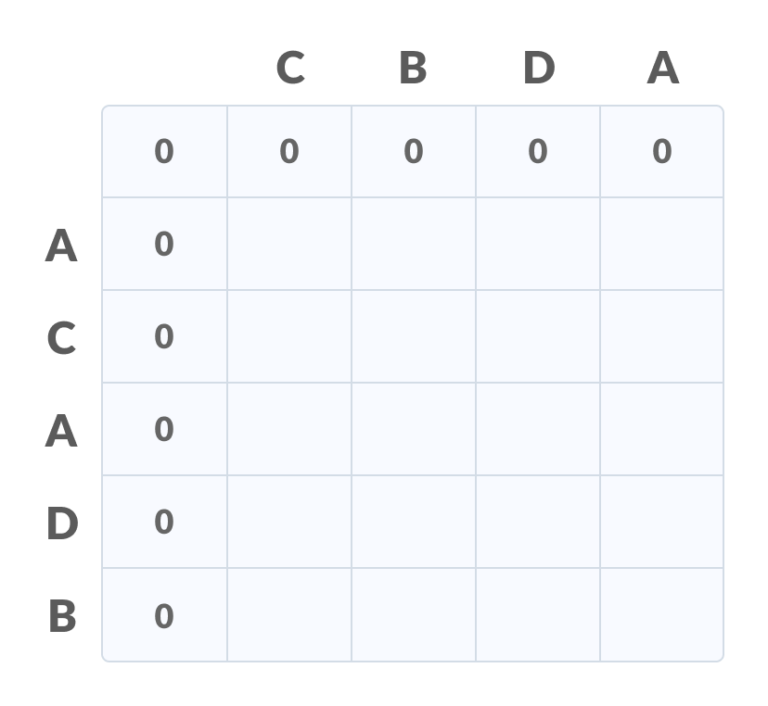
Longest Common Sub Sequence(CO4)
Fill each cell of the table using the following logic.
If the character correspoding to the current row and current column are matching, then fill the current cell by adding one to the diagonal element. Point an arrow to the diagonal cell.
Else take the maximum value from the previous column and previous row element for filling the current cell. Point an arrow to the cell with maximum value. If they are equal, point to any of them.

Slide 46
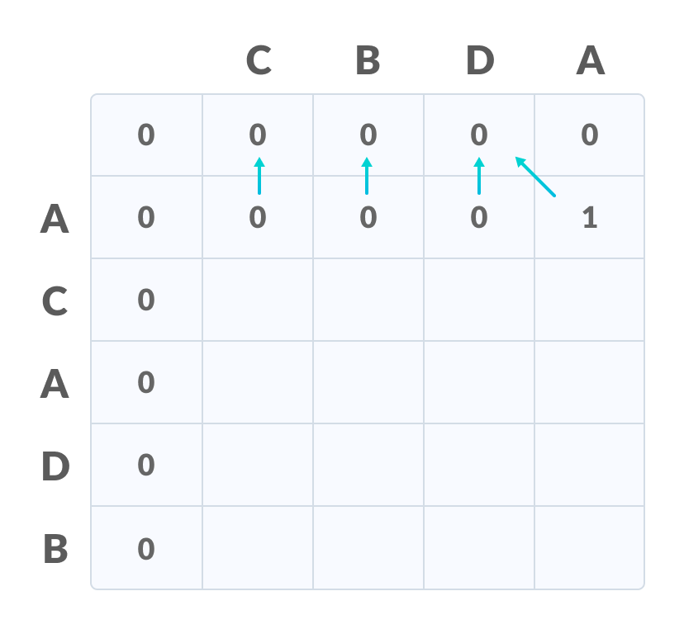
Longest Common Sub Sequence(CO4)
Step 2 is repeated until the table is filled.

Slide 47
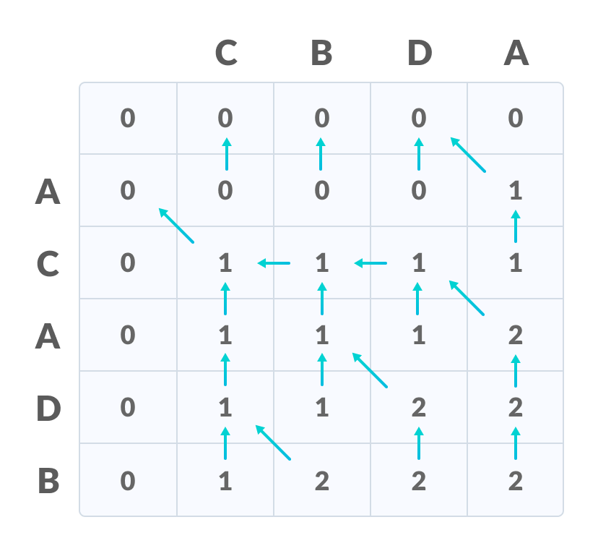
Longest Common Sub Sequence(CO4)
The value in the last row and the last column is the length of the longest common subsequence.

Slide 48
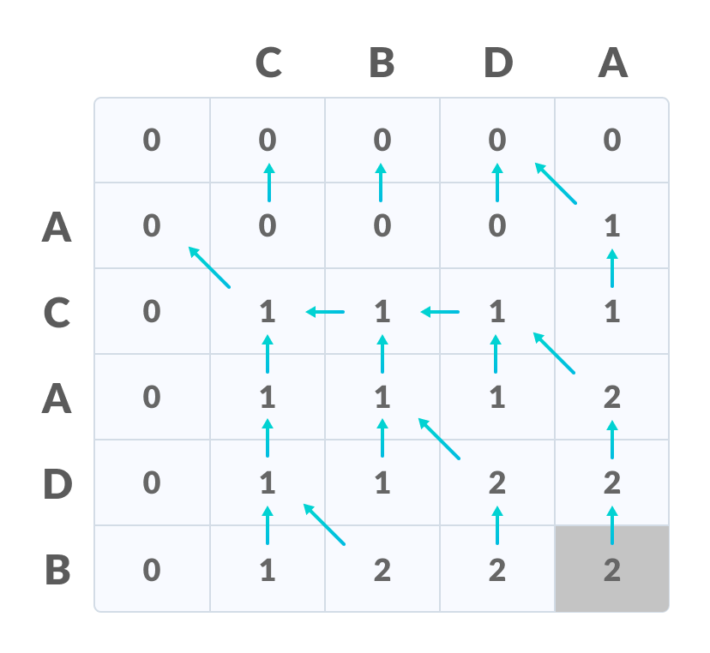
Longest Common Sub Sequence(CO4)
In order to find the longest common subsequence, start from the last element and follow the direction of the arrow. The elements corresponding to () symbol form the longest common subsequence.

Slide 49
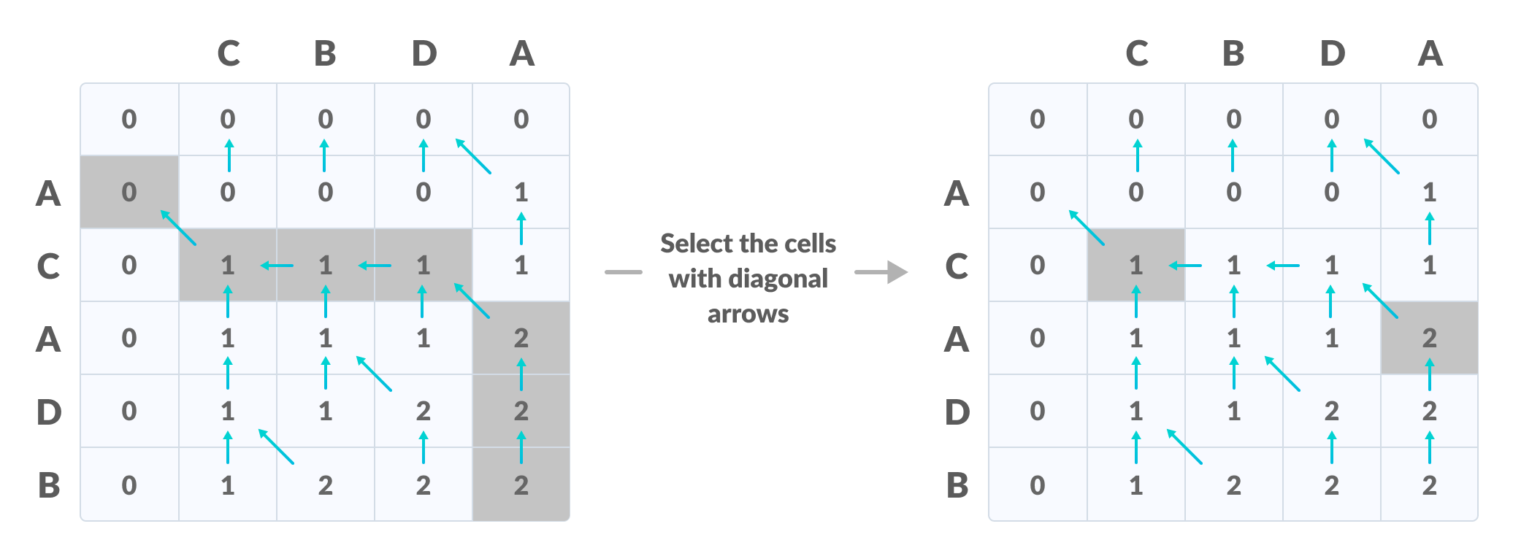
Longest Common Sub Sequence(CO4)
Thus, the longest common subsequence is C,A

Slide 50
Longest Common Sub Sequence(CO4)
How is a dynamic programming algorithm more efficient than the recursive algorithm while solving an LCS problem?
The method of dynamic programming reduces the number of function calls. It stores the result of each function call so that it can be used in future calls without the need for redundant calls.
In the above dynamic algorithm, the results obtained from each comparison between elements of X and the elements of Y are stored in a table so that they can be used in future computations.
So, the time taken by a dynamic approach is the time taken to fill the table (ie. O(mn)). Whereas, the recursion algorithm has the complexity of 2^{max(m,n)}

Slide 51
Longest Common Sub Sequence(CO4)
Longest Common Subsequence Algorithm
X and Y be two given sequences
Initialize a table LCS of dimension X.length * Y.length
X.label = X
Y.label = Y
LCS[0][] = 0
LCS[][0] = 0
Start from LCS[1][1]
Compare X[i] and Y[j]
If X[i] = Y[j]
LCS[i][j] = 1 + LCS[i-1, j-1]
Point an arrow to LCS[i][j]
Else
LCS[i][j] = max(LCS[i-1][j], LCS[i][j-1])
Point an arrow to max(LCS[i-1][j], LCS[i][j-1])

Slide 52
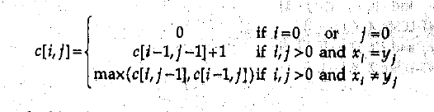
Longest Common Sub Sequence(CO4)
Q) Find the longest common subsequence of the sequences X= <1, 0, 0, 1, 0, 1, 0, 1> and Y=< 0, 1, 0, 1, 1, 0, 1, 1, 0>
Sol .length of X=8 and length of Y =9
Draw a table with 9 rows (from 0 – 8 , for X values) and 10 columns (from 0 – 9, for Y values)
We know the formula

Slide 53
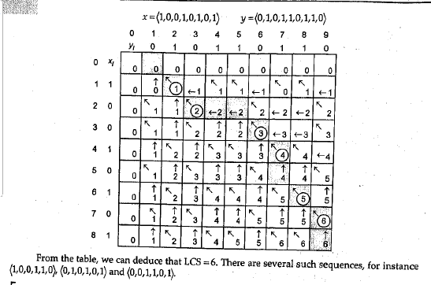
Longest Common Sub Sequence(CO4)

Slide 54
Longest Common Sub Sequence(CO4)
Q1. Determine the LCS of < 1, 0, 0, 1, 0, 1, 0, 1> and < 0, 1, 0, 1, 1, 0, 1, 1, 0 >
Q2. Determine LCS of < A, B, C, D, B, A, C, D, F> and < C, B, A, F >

Slide 55
Matrix Chain Multiplication
Matrix Chain Multiplication is an algorithm that is applied to determine the lowest cost way for multiplying matrices.
The actual multiplication is done using the standard way of multiplying the matrices, i.e., it follows the basic rule that the number of rows in one matrix must be equal to the number of columns in another matrix.
Hence, multiple scalar multiplications must be done to achieve the product.

Slide 56
Matrix Chain Multiplication
consider matrices A, B, C, and D, to be multiplied; hence, the multiplication is done using the standard matrix multiplication. There are multiple combinations of the matrices found while using the standard approach since matrix multiplication is associative. For instance, there are five ways to multiply the four matrices given above −
(A(B(CD)))
(A((BC)D))
((AB)(CD))
((A(BC))D)
(((AB)C)D)

Slide 57
Matrix Chain Multiplication
Now, if the size of matrices A, B, C, and D are l × m, m × n, n × p, p × q respectively, then the number of scalar multiplications performed will be lmnpq.
But the cost of the matrices change based on the rows and columns present in it. Suppose, the values of l, m, n, p, q are 5, 10, 15, 20, 25 respectively, the cost of (A(B(CD))) is 5 × 100 × 25 = 12,500; however, the cost of (A((BC)D)) is 10 × 25 × 37 = 9,250.
So, dynamic programming approach of the matrix chain multiplication is adopted in order to find the combination with the lowest cost.

Slide 58
Matrix Chain Multiplication
Matrix chain multiplication algorithm is only applied to find the minimum cost way to multiply a sequence of matrices. Therefore, the input taken by the algorithm is the sequence of matrices while the output achieved is the lowest cost parameterization.
1. Count the number of parameterizations. Find the number of ways in which the input matrices can be multiplied.
2. Once the parameterization is done, the optimal substructure must be devised as the first step of dynamic programming approach so the final product achieved is optimal. In matrix chain multiplication, the optimal substructure is found by dividing the sequence of matrices A[i….j] into two parts A[i,k] and A[k+1,j]. It must be ensured that the parts are divided in such a way that optimal solution is achieved. Find the lowest cost parameterization of the sequence of matrices by constructing cost tables and corresponding k values table.

Slide 59
Matrix Chain Multiplication
3. Once the lowest cost is found, print the corresponding parameterization as the output.

Slide 60
Matrix Chain Multiplication
Pseudocode
MATRIX-CHAIN-MULTIPLICATION(p)
n = p.length ─ 1
let m[1…n, 1…n] and s[1…n ─ 1, 2…n] be new matrices
for i = 1 to n
m[i, i] = 0
for l = 2 to n // l is the chain length
for i = 1 to n - l + 1
j = i + l - 1
m[i, j] = ∞
for k = i to j - 1
q = m[i, k] + m[k + 1, j] + pi-1pkpj
if q < m[i, j]
m[i, j] = q

Slide 61
Matrix Chain Multiplication
Pseudocode to print the optimal output parameterization −
PRINT-OPTIMAL-OUTPUT(s, i, j )
if i == j
print “A”I
else
print “(” PRINT-OPTIMAL-OUTPUT(s, i, s[i, j])
PRINT-OPTIMAL-OUTPUT(s, s[i, j] + 1, j) print “)”

Slide 62
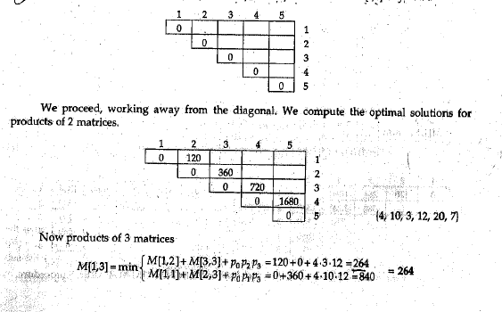
Matrix Chain Multiplication
We have set of matrices of order 4X10, 10X3, 3X12, 12X20, 20X7 respectively. Determine the way in which we can multiply the matrices in minimum cost.

Slide 63
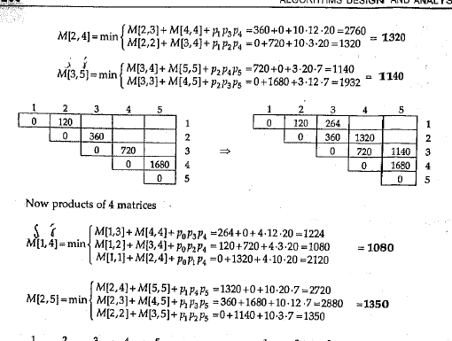
Matrix Chain Multiplication

Slide 64
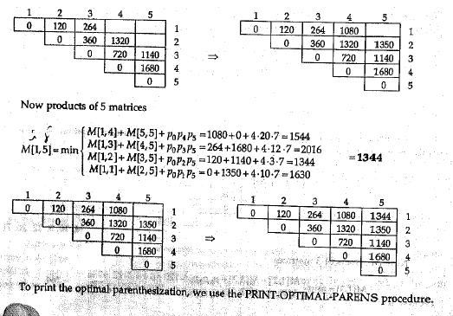
Matrix Chain Multiplication

Slide 65
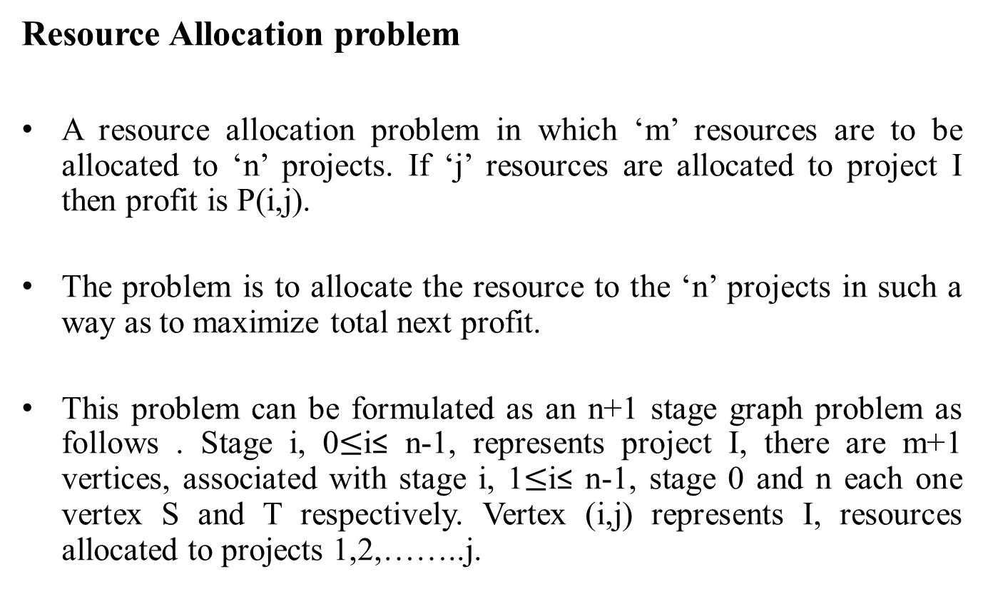
Dynamic Programming(CO4)
Resource Allocation problem
A resource allocation problem in which ‘m’ resources are to be allocated to ‘n’ projects. If ‘j’ resources are allocated to project I then profit is P(i,j).
The problem is to allocate the resource to the ‘n’ projects in such a way as to maximize total next profit.
This problem can be formulated as an n+1 stage graph problem as follows . Stage i, 0$≤$i≤ n-1, represents project I, there are m+1 vertices, associated with stage i, 1$≤$i≤ n-1, stage 0 and n each one vertex S and T respectively. Vertex (i,j) represents I, resources allocated to projects 1,2,……..j.

Slide 66
Dynamic Programming(CO4)
Resource Allocation problem
An optimal allocation of resources is defined by a maximum cost of a path from S to T.
A dynamic programming formulation for a k-stage is obtained by first noticing that every S to T path is result of a sequence k-2 decisions.
Let c(S,k) be a cost of path from node S to k and d( k, T) be the cost of path from node k to T, via. some intermediate node , which can be calculated recursively.
d(S,T)= max{c(S,k) +d(k,T)}

Slide 67
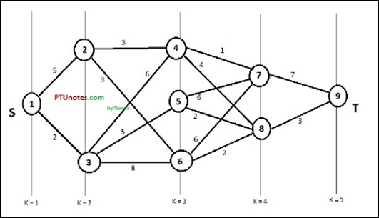
Dynamic Programming(CO4)
Consider the following example to understand the concept of multistage graph.
https://www.tutorialspoint.com/design_and_analysis_of_algorithms/design_and_analysis_of_algorithms_multistage_graph.htm

Slide 68
Dynamic Programming(CO4)
According to the formula, we have to calculate the cost (i, j) using the following steps
Step-1: Cost (K-2, j)
In this step, three nodes (node 4, 5. 6) are selected as j. Hence, we have three options to choose the minimum cost at this step.
Cost(3, 4) = min {c(4, 7) + Cost(7, 9),c(4, 8) + Cost(8, 9)} = 7
Cost(3, 5) = min {c(5, 7) + Cost(7, 9),c(5, 8) + Cost(8, 9)} = 5
Cost(3, 6) = min {c(6, 7) + Cost(7, 9),c(6, 8) + Cost(8, 9)} = 5

Slide 69
Dynamic Programming(CO4)
Step-2: Cost (K-3, j)
Two nodes are selected as j because at stage k - 3 = 2 there are two nodes, 2 and 3. So, the value i = 2 and j = 2 and 3.
Cost(2, 2) = min {c(2, 4) + Cost(4, 8) + Cost(8, 9),c(2, 6) +
Cost(6, 8) + Cost(8, 9)}
= 8
Cost(2, 3) = {c(3, 4) + Cost(4, 8) + Cost(8, 9), c(3, 5) + Cost(5, 8)+
Cost(8, 9), c(3, 6) + Cost(6, 8) + Cost(8, 9)}
= 10

Slide 70
Dynamic Programming(CO4)
Step-3: Cost (K-4, j)
Cost (1, 1) = {c(1, 2) + Cost(2, 6) + Cost(6, 8) + Cost(8, 9), c(1, 3) +
Cost(3, 5) + Cost(5, 8) + Cost(8, 9))}
= 12
c(1, 3) + Cost(3, 6) + Cost(6, 8 + Cost(8, 9))} = 13
Hence, the path having the minimum cost is 1→ 3→ 5→ 8→ 9.
For more examples refer the video
https://www.youtube.com/watch?v=9iE9Mj4m8jk

Slide 71
Backtracking(CO4)- Objective
This objective of this topic is to make students understand about
Concepts of Backtracking
Graph Colouring
N-Queens
Sum of Subsets
Hamiltonian Cycle

Slide 72
Prerequisite and Recap
Prerequisite
Algorithms Concepts
C programming
Graph
Recap
Dynamic Programming

Slide 73
Backtracking (CO4)
Backtracking is an algorithmic-technique for solving problems recursively by trying to build a solution incrementally, one piece at a time, removing those solutions that fail to satisfy the constraints of the problem at any point of time.
It is a technique based on algorithm to solve problem. It uses recursive calling to find the solution by building a solution step by step increasing values with time.
It removes the solutions that doesn't give rise to the solution of the problem based on the constraints given to solve the problem.

Slide 74
Backtracking
Backtracking algorithm is applied to some specific types of problems.
Decision problem used to find a feasible solution of the problem.
Optimisation problem used to find the best solution that can be applied.
Enumeration problem used to find the set of all feasible solutions of the problem
In backtracking problem, the algorithm tries to find a sequence path to the solution which has some small checkpoints from where the problem can backtrack if no feasible solution is found for the problem.

Slide 75
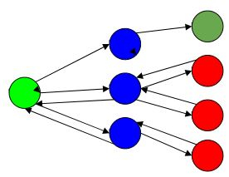
Backtracking
For Example,
Here, Green is the start point, blue is the intermediate point, red are points with no feasible solution, dark green is end solution.
when the algorithm propagates to an end to check if it is a solution or not, if it is then returns the solution otherwise backtracks to the point one step behind it to find track to the next point to find solution.

Slide 76
Backtracking
ALGORITHM
Step 1 − if current_position is goal, return success
Step 2 − else,
Step 3− if current_position is an end point, return failed.
Step 4− else, if current_position is not end point, explore and repeat above steps.

Slide 77
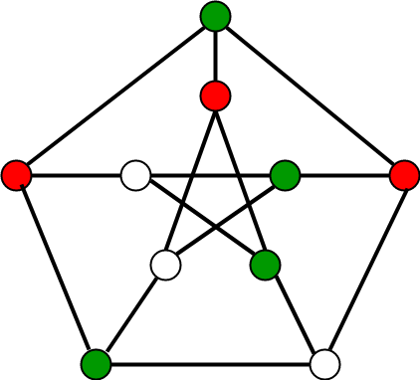
Backtracking
Graph Colouring Problem
Given an undirected graph and a number m, determine if the graph can be coloured with at most m colours such that no two adjacent vertices of the graph are colored with the same color.
Here coloring of a graph means the assignment of colors to all vertices.

Slide 78
Backtracking
Graph Colouring Problem
Input:
A 2D array graph[V][V] where V is the number of vertices in graph and graph[V][V] is adjacency matrix representation of the graph.
A value graph[i][j] is 1 if there is a direct edge from i to j, otherwise graph[i][j] is 0.
An integer m which is the maximum number of colors that can be used
Output: An array color[V] that should have numbers from 1 to m. color[i] should represent the color assigned to the ith vertex.

Slide 79
Backtracking
N- Queens Problem
N - Queens problem is to place n - queens in such a manner on an n x n chessboard that no queens attack each other by being in the same row, column or diagonal.
It can be seen that for n =1, the problem has a trivial solution, and no solution exists for n =2 and n =3.
So first we will consider the 4 queens problem and then generate it to n - queens problem.
Given a 4 x 4 chessboard and number the rows and column of the chessboard 1 through 4.

Slide 80
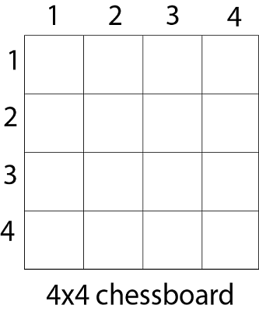
Backtracking
N- Queens Problem
Since, we have to place 4 queens such as q₁ q₂ q₃ and q₄ on the chessboard, such that no two queens attack each other. In such a conditional each queen must be placed on a different row, i.e., we put queen "i" on row "i."

Slide 81
Backtracking
N- Queens Problem
Now, we place queen q₁ in the very first acceptable position (1, 1).
Next, we put queen q₂ so that both these queens do not attack each other.
We find that if we place q₂ in column 1 and 2, then the dead end is encountered.
Thus the first acceptable position for q₂ in column 3, i.e. (2, 3) but then no position is left for placing queen 'q₃' safely.

Slide 82
Backtracking
N- Queens Problem
So we backtrack one step and place the queen 'q₂' in (2, 4), the next best possible solution. Then we obtain the position for placing 'q₃' which is (3, 2).
But later this position also leads to a dead end, and no place is found where 'q₄' can be placed safely.
Then we have to backtrack till 'q₁' and place it to (1, 2) and then all other queens are placed safely by moving q₂ to (2, 4), q₃ to (3, 1) and q₄ to (4, 3).

Slide 83
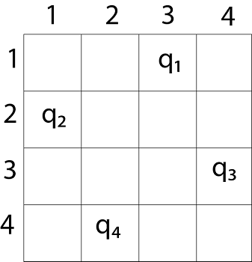
Backtracking
N- Queens Problem
That is, we get the solution (2, 4, 1, 3).
This is one possible solution for the 4-queens problem.
For another possible solution, the whole method is repeated for all partial solutions. The other solutions for 4 - queens problems is (3, 1, 4, 2) i.e.

Slide 84
Backtracking
N- Queens Problem
Fig shows the complete state space for 4 - queens problem. But we can use backtracking method to generate the necessary node and stop if the next node violates the rule, i.e., if two queens are attacking.
It can be seen that all the solutions to the 4 queens problem can be represented as 4 - tuples (x₁, x₂, x₃, x₄) where x_{i} represents the column on which queen "q_{i}" is placed.

Slide 85
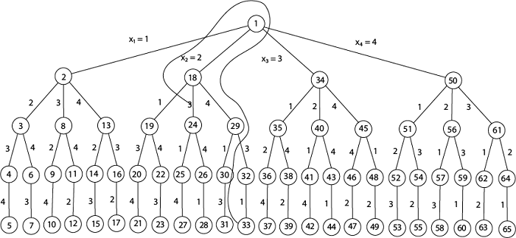
Backtracking
4- Queens Problem

Slide 86
Backtracking
N- Queens Problem
Place (k, i)
{
For j ← 1 to k - 1
do if (x [j] = i)
or (Abs x [j]) - i) = (Abs (j - k))
then return false;
return true;
}
Place (k, i) return true if a queen can be placed in the kth row and ith column otherwise return is false.
x [] is a global array whose final k - 1 values have been set. Abs (r) returns the absolute value of r.

Slide 87
Backtracking
N- Queens Problem
x [] is a global array whose final k - 1 values have been set. Abs (r) returns the absolute value of r.
N - Queens (k, n)
{
For i ← 1 to n
do if Place (k, i) then
{
x [k] ← i;
if (k ==n) then
write (x [1....n));
else
N - Queens (k + 1, n);
}
}

Slide 88
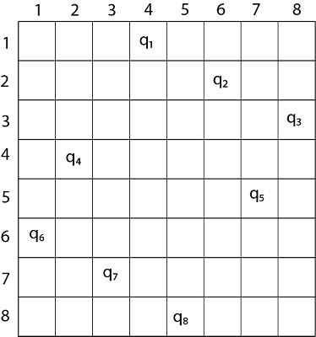
Backtracking
8- Queens Problem
Thus, the solution for 8 -queen problem for (4, 6, 8, 2, 7, 1, 3, 5).
If two queens are placed at position (i, j) and (k, l).
Then they are on same diagonal only if (i - j) = k - l or i + j = k + l.
The first equation implies that j - l = i - k.
The second equation implies that j - l = k - i.
Therefore, two queens lie on the duplicate diagonal if and only if |j-l|=|i-k|

Slide 89
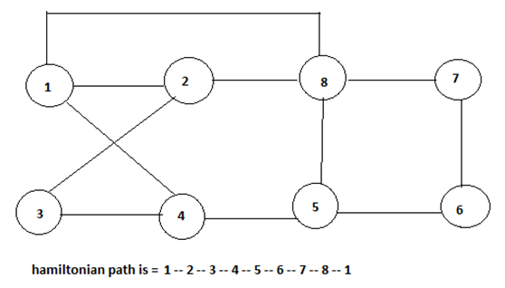
Backtracking
Hamiltonian Cycles
Hamiltonian Path in an undirected graph is a path that visits each vertex exactly once.
A Hamiltonian cycle (or Hamiltonian circuit) is a Hamiltonian Path such that there is an edge (in the graph) from the last vertex to the first vertex of the Hamiltonian Path.

Slide 90
Backtracking
Sum of Subsets Problem
Subset sum problem is to find subset of elements that are selected from a given set whose sum adds up to a given number K.
We are considering the set contains non-negative values. It is assumed that the input set is unique (no duplicates are presented).
Here backtracking approach is used for trying to select a valid subset when an item is not valid, we will backtrack to get the previous subset and add another element to get the solution.

Slide 91
Backtracking
Sum of Subsets Problem
Subset sum problem is to find subset of elements that are selected from a given set whose sum adds up to a given number K.
We are considering the set contains non-negative values. It is assumed that the input set is unique (no duplicates are presented).
Here backtracking approach is used for trying to select a valid subset when an item is not valid, we will backtrack to get the previous subset and add another element to get the solution.

Slide 92
Backtracking
Sum of Subsets Problem
Backtracking Algorithm for Subset Sum
Using exhaustive search we consider all subsets irrespective of whether they satisfy given constraints or not. Backtracking can be used to make a systematic consideration of the elements to be selected.
Algorithm
subsetSum(set, subset, n, subSize, total, node, sum)
Input: The given set and subset, size of set and subset, a total of the subset, number of elements in the subset and the given sum.
Output: All possible subsets whose sum is the same as the given sum.
.

Slide 93
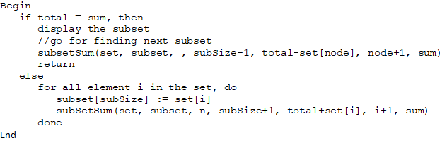
Backtracking
Sum of Subsets Algorithm

Slide 94
Backtracking
Sum of Subsets Example
Given a set S = (3, 4, 5, 6) and X =9. Obtain the subset sum using Backtracking approach.
Solution:
Initially S = (3, 4, 5, 6) and X =9.
S'= (∅)
The implicit binary tree for the subset sum problem is shown in Fig.
The number inside a node is the sum of the partial solution elements at a particular level.
Thus, if our partial solution elements sum is equal to the positive integer 'X' then at that time search will terminate, or it continues if all the possible solution needs to be obtained.

Slide 95
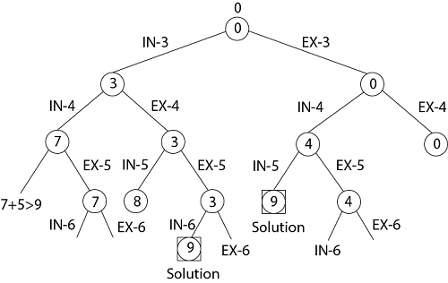
Backtracking
Sum of Subsets Example

Slide 96
Backtracking
Sum of Subsets Example
Input: The Set: {10, 7, 5, 18, 12, 20, 15}
The sum Value: 35
Output:
All possible subsets of the given set, where sum of each element for every subsets is same as the given sum value.
{10, 7, 18}
{10, 5, 20}
{5, 18, 12}
{20, 15}

Slide 97
Branch and Bound(CO4)- Objective
This objective of this topic is to make students understand about
Concepts of Branch and Bound
Travelling Salesman Problem

Slide 98
Prerequisite and Recap
Prerequisite
Algorithms Concepts
C programming
Graph
Recap
Backtracking

Slide 99
Branch and Bound (CO4)
Branch and bound is an algorithm design paradigm which is generally used for solving combinatorial optimization problems.
These problems are typically exponential in terms of time complexity and may require exploring all possible permutations in worst case.
The Branch and Bound Algorithm technique solves these problems relatively quickly.

Slide 100
Branch and Bound
Travelling Salesman Problem
Given a set of cities and distance between every pair of cities, the problem is to find the shortest possible tour that visits every city exactly once and returns to the starting point.
In Branch and Bound method, for current node in tree, we compute a bound on best possible solution that we can get if we down this node.
If the bound on best possible solution itself is worse than current best (best computed so far), then we ignore the subtree rooted with the node.

Slide 101
Branch and Bound
Travelling Salesman Problem
Note that the cost through a node includes two costs.
1) Cost of reaching the node from the root (When we reach a node, we have this cost computed)
2) Cost of reaching an answer from current node to a leaf (We compute a bound on this cost to decide whether to ignore subtree with this node or not).

Slide 102

Branch and Bound
Travelling Salesman Problem- Example
In this method we expand the node which is most promising means the node which promises that expanding or choosing it will give us the optimal solution.
So we prepare the tree starting from root then we expand it.
The cost matrix is defined by
C(i,j) = W(i,j) , if there is a direct path from Ci to Cj.
= $∞$, If there is no direct path from Ci to Cj.

Slide 103
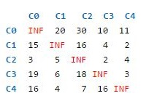
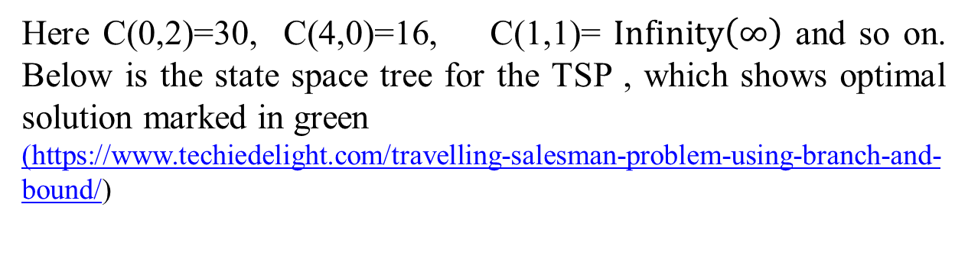
Branch and Bound
Travelling Salesman Problem- Example
Consider the following cost matrix
Here C(0,2)=30, C(4,0)=16, C(1,1)= $Infinity\left(∞\right)$ and so on. Below is the state space tree for the TSP , which shows optimal solution marked in green
(https://www.techiedelight.com/travelling-salesman-problem-using-branch-and-bound/)

Slide 104
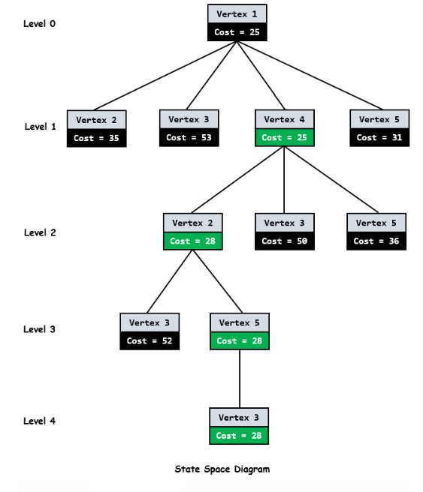
Branch and Bound
.

Slide 105
Branch and Bound
Travelling Salesman Problem- Steps
As we can see from above diagram , every node has a cost associated to it.
When we go from city I to city j, cost of a node j will be sum of cost of parent node I, cost of the edge (I,j) and lower bound of the path starting at node j.
As root node is the first node to be expanded , it doesn’t have any parent. So cost will be only lower bound of the path starting at root.
To get the lower bound of the path starting from the node , we reduce each row and column in such a wat that there must be atleast one zero in each row and column.
.

Slide 106
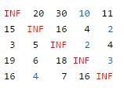
Branch and Bound
.
For doing this, we need to reduce the minimum value from each element in each row and column.
Let’s start from root node
We reduce the minimum value in each row from each element in that row.
Minimum in each row of cost matrix M is marked by blue[10,2,2,3,4] below.

Slide 107
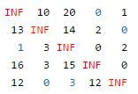
Branch and Bound
.
After reducing the row, we get the below matrix. We then reduce the minimum value in each column from each element in that column.
Minimum in each column is marked by blue[1 0 3 0 0]. After reducing the column, we get below reduced matrix. This matrix will be further processed by child nodes of root node to calculate their lower bound.

Slide 108
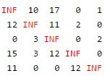
Branch and Bound
.
The total expected cost at the root node is sum of all reductions.
Cost=[10 2 2 3 4] + [1 0 3 0 0]= 25
Since we have discovered the root node C0, the next node to be expanded can be any node from C1,C2, C3, C4. Whichever node has minimum cost, that node will be expanded further. So we have to find out the expanding cost of each node.

Slide 109
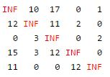
Branch and Bound
The parent node (C0) has below reduced matrix-
Let us consider edge from 0→ 1
As we are adding edge (0,1) to our search space, we get outgoing edges for city 0 to infinity and all incoming edges to city 1 to infinity. We also set (1,0) to infinity.
So in reduced matrix of parent node we change all the elements in
row 0 and column 1 and at index (1,0) to infinity(marked in red).
.

Slide 110
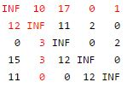
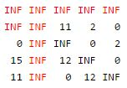
Branch and Bound
.
The resulting cost matrix is

Slide 111
Branch and Bound
.
3. We try to calculate lower bound of the path starting at node 1 using above resulting cost matrix.
4. The lower bound is 0 as matrix is already in reduced form. i.e. all rows and all columns have zero value.
Therefore for node 1, cost will be
Cost= cost of node 0 + cost of the edge (0,1) + lower bound of the
path starting at node 1
= 25 + 10 +0= 35

Slide 112
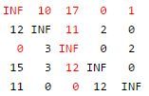
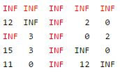
Branch and Bound
.
Change all the elements in row 0 and column 2 and at index(2,0) to infinity(marked in red).
The resulting cost matrix is:
Lets consider edge from 0→ 2

Slide 113
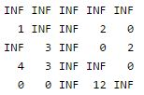
Branch and Bound
Now calculate lower bound of the path starting at node 2 using the
Approach discussed earlier. Resulting matrix will be-
Therefore the cost of node 2, cost will be
Cost = Cost of node 0 + cost of the edge (0,2) + Lower bound of the
path starting at node 2
= 25 + 17 + 11= 53

Slide 114


Branch and Bound
Let us consider edge from 0→ 3
Change the elements in row 0 and column 3 and at index(3,0) to
Infinity(marked in red).
The Resulting cost matrix is :

Slide 115
Branch and Bound
Now calculate lower bound of the path starting at node 3 using the
Approach discussed earlier.
Lower bound of the path starting at node 3 is 0 as it is already in reduced form, i.e. all rows and all columns have zero value.
Therefore for node 3, cost will be
Cost = Cost of node 0 + cost of the edge (0,3) + Lower bound of the
path starting at node 3
= 25 + 0 + 0= 25
Similarly we calculate for 0→ 4. Its cost will be 31.

Slide 116
Branch and Bound
Now we find a live node with estimated cost. Live nodes 1,2,3 and 4 has costs 35, 53, 25 and 31 respectively.
The minimum among them is node 3 having cost 25. So node 3 will be expanded further as shown in state space tree diagram.
After adding its children to list of live nodes, we again find a live node with least cost and expand it.
We continue the search till a leaf is encountered in space search tree. If a leaf is encountered, then the tour is completed and we will return back to the root node.

Slide 117
Faculty Video Links, Youtube & NPTEL Video Links and Online Courses Details
Youtube/other Video Links
https://www.youtube.com/watch?v=oNI0rf2P9gE
https://www.youtube.com/watch?v=9iE9Mj4m8jk
https://www.youtube.com/watch?v=kyLxTdsT8ws
https://nptel.ac.in/courses/106106133/

Slide 118
Quiz
The problem of placing n queens in a chessboard such that no two queens attack each other is called as________________.
___________ enumerates a list of promising nodes that could be computed to give the possible solutions of a given problem.
When dynamic programming is applied to a problem, it takes far less time as compared to other methods that don’t take advantage of overlapping subproblems.(True/False).
Branch and bound is a __________
Both LIFO branch and bound strategy and backtracking leads to depth first search.(True/False)

Slide 119
Quiz
6. __________can traverse the state space tree only in DFS manner?
A node is said to be ____________ if it has a possibility of reaching a complete solution.
A state-space tree for a backtracking algorithm is constructed using ______________________.
The leaves in a state-space tree represent only complete solutions.(True / False)
Backtracking algorithm is faster than the brute force technique(True/ False)

Slide 120
Weekly Assignment
Explain Floyd algorithm and also analyze its complexity. [CO4]
What is nQueens problem? Write the steps for solving the nQueens problem. [CO4]
Explain Graph colouring Problem with the help of suitable example. [CO4]
4. Find the optimal solution to the knapsack 0/1 instances n=7,m=15.
(V_{1,}V_{2,}V_{3,}V_{4,}V_{5,}V_{6,}V₇)=(10,5,15,7,6,18,3)
(W_{1,}W_{2,}W_{3,}W_{4,}W_{5,}W_{6,}W₇ )=(2,3,5,7,1,4,1) [CO4]
Let S={4,6,7,8} and m=18. Find all possible subsets of S that sums to m. Draw state space tree that is generated. [CO4]
Use Floyd Warshall algorithm to find shortest path for all of the vertices of the given graph. Give the complexity of the algorithm.
[CO4]

Slide 121

Weekly Assignment
6. Consider following instance for simple Knapsack Problem. Find the solution using greedy method. N:8, Value of knapsack is 110.
V : { 30,20,100,90,160,200,180,220}
W : {5, 10, 20,22,33, 43, 45, 55} [CO4]
7. Write short note on Branch and Bound Technique. [CO4]

Slide 122
MCQ
Which of the following is/are property/properties of a dynamic programming problem? a) Optimal substructure b) Overlapping subproblems c) Greedy approach d) Both optimal substructure and overlapping subproblems
If a problem can be broken into subproblems which are reused several times, the problem possesses ____________ property. a) Overlapping subproblems b) Optimal substructure c) Memoization d) Greedy

Slide 123
MCQ
When dynamic programming is applied to a problem, it takes far less time as compared to other methods that don’t take advantage of overlapping subproblems. a) True b) False
Which of the following problems is NOT solved using dynamic programming? a) 0/1 knapsack problem b) Matrix chain multiplication problem c) Edit distance problem d) Fractional knapsack problem

Slide 124
MCQ
Which of the following problems should be solved using dynamic programming? a) Mergesort b) Binary search c) Longest common subsequence d) Quicksort
If a problem can be solved by combining optimal solutions to non-overlapping problems, the strategy is called _____________ a) Dynamic programming b) Greedy c) Divide and conquer d) Recursion

Slide 125
MCQ
Which of the problems cannot be solved by backtracking method? a) n-queen problem b) subset sum problem c) hamiltonian circuit problem d) travelling salesman problem
Backtracking algorithm is implemented by constructing a tree of choices called as? a) State-space tree b) State-chart tree c) Node tree d) Backtracking tree

Slide 126
MCQ
In what manner is a state-space tree for a backtracking algorithm constructed? a) Depth-first search b) Breadth-first search c) Twice around the tree d) Nearest neighbour first
The problem of finding a subset of positive integers whose sum is equal to a given positive integer is called as? a) n- queen problem b) subset sum problem c) knapsack problem d) hamiltonian circuit problem

Slide 127
Glossary Question
Q.1The 0/1 Knapsack problem is an example of ____________ a) Greedy algorithm b) 2D dynamic programming c) 1D dynamic programming d) Divide and conquer
Q.2 __________method can be used to solve the Knapsack problem? a) Brute force algorithm b) Recursion c) Dynamic programming d) Brute force, Recursion and Dynamic Programming
Q.3 ______ is used to solve the matrix chain multiplication problem? a) Dynamic programming b) Brute force c) Recursion d) Dynamic Programming, Brute force, Recursion

Slide 128
Glossary Question
Q.4 ________ problems can be solved using the longest subsequence problem? a) Longest increasing subsequence b) Longest palindromic subsequence c) Longest bitonic subsequence d) Longest decreasing subsequence
Q.5 ___________is the worst case time complexity of dynamic programming solution of the subset sum problem(sum=given subset sum)? a) O(n) b) O(sum) c) O(n²) d) O(sum*n)
Q.6 In ______ directions queens attack each other? a) 1 b) 2 c) 3 d) 4

Slide 129
Glossary Question
Q.7 Placing n-queens so that no two queens attack each other is called__________ a) n-queen’s problem b) 8-queen’s problem c) Hamiltonian circuit problem d) subset sum problem
Q.8 The n-queens problem implemented in _________. a) carom b) chess c) ludo d) cards
Q.9 __________methods can be used to solve n-queen’s problem. a) greedy algorithm b) divide and conquer c) iterative improvement d) backtracking

Slide 130
Important Questions from Old Question Papers(2022-202)
Q1. Discuss the matrix chain multiplication algorithm with the example using
four matrices.
Q2. Write an algorithm for solving n-queen problem. Show the solution of
4 queen problem using backtracking approach.
Q3. Discuss knapsack problem with respect to dynamic programming
approach. Find the optimal solution for given solution for given problem,
w (weight set) ={5, 10,15,20} and W (Knapsack size) = 25,
V(value set)={50, 60 120, 100}.

Slide 131

Old Question Papers(2021-2022)

Slide 132

Old Question Papers(2021-2022)

Slide 133


Old Question Papers(2021-2022)

Slide 134

Old Question Papers(2021-2022)

Slide 135


Old Question Papers(2021-2022)

Slide 136


Old Question Papers(2020-2021)

Slide 137

Old Question Papers(2020-2021)

Slide 138


Old Question Papers(2020-2021)

Slide 139


Old Question Papers(2020-2021)

Slide 140

Old Question Papers(2020-2021)

Slide 141


Old Question Papers(2019-2020)

Slide 142


Old Question Papers(2019-2020)

Slide 143


Old Question Papers(2019-2020)

Slide 144

Old Question Papers(2019-2020)

Slide 145

Old Question Papers(2019-2020)

Slide 146

Expected Questions for University Exam
Solve the problem of travelling salesman problem on following graph and perform operation for each vertex. [CO4]
2. Write Short notes on the following. [CO4] i) Graph Coloring
ii)Sub Set Sum Problem
iii)Hamiltonian Cycle

Slide 147
Expected Questions for University Exam
3. Find out one optimal solution for following using back tracking.
4*4 chessboard,4 Queen Problem
8*8 chessboard,8 Queen Problem [CO4]
4. Write the difference between the Greedy method and Dynamic programming. [CO4]
Explain the term state space search tree with suitable example. [CO4]
6. Explain Floyd algorithm and also analyze its complexity [CO4]

Slide 148
Recap of Unit
This unit gives the insights of different techniques like Dynamic Programming, Back tracking and Branch and Bound . Different real world problem have been solved with these approaches.
The problems discussed here are Travelling salesman Problem, n Queens problem , Sum of subsets problem, Floyd Warshall algorithm, Knapsack Problem, Graph Colouring and Hamiltonion Cycle.

Slide 149
Unit 4
Thank You

